Slide 1

Smart Energy Consumption Prediction and Optimization Platform
Done by:
S.Vyshnavi ( IT 24245A1212)
K.Srikari ( IT 23241A1296)
B.Nandini ( IT 24245A1208)

Slide 2

Abstract
This project presents a smart energy consumption prediction and optimization system for residential households using historical electricity consumption data. The system analyzes past usage patterns along with factors such as time, day, and seasonal variations to accurately predict future energy demand using machine learning and deep learning techniques. Based on the predictions, an optimization strategy is applied to reduce energy consumption and shift flexible loads away from peak hours while maintaining user comfort. The system provides predicted energy values, peak and off-peak analysis, optimized usage plans, and cost-saving insights. The results demonstrate improved energy efficiency, reduced peak demand, and effective support for sustainable household energy management.

Slide 3

Introduction
Energy consumption is increasing rapidly due to population growth, urbanization, and increased dependency on electrical appliances. Traditional energy usage systems lack intelligence and automation, leading to energy wastage and high electricity costs. Smart energy management systems use prediction and optimization techniques to analyze consumption patterns and provide efficient usage strategies. This project focuses on predicting future energy consumption and optimizing usage for better efficiency and sustainability.

Slide 4

Problem Statement
The continuous increase in electricity consumption has resulted in inefficient appliance usage, high peak loads, and increased electricity bills. Existing systems do not provide intelligent prediction mechanisms to forecast energy demand or optimize usage patterns. The absence of smart prediction and optimization systems leads to poor energy planning and inefficient consumption management.

Slide 5
Objectives
The main objective of this project is to analyze historical energy consumption data and predict future energy usage using machine learning and deep learning techniques. It also aims to identify peak and off-peak periods, optimize energy usage patterns, reduce electricity costs, and improve overall energy efficiency.

Slide 6
Literature Survey
Various traditional energy monitoring systems and statistical forecasting methods have been studied to understand existing approaches. Machine learning models and deep learning techniques such as LSTM have been explored for time-series energy prediction. The literature review highlights that although many systems exist, there is a research gap in combining accurate prediction with practical energy optimization and user-friendly visualization systems.

Slide 7
Scope of the Project
The project mainly focuses on residential household energy consumption. It aims at reducing energy costs, promoting sustainable energy usage, and improving efficiency. The system can be further extended to smart homes, smart buildings, and smart grid environments for large-scale energy management.

Slide 8
System Architecture
Data collection
Preprocessing
Prediction model
Optimization module
Visualization dashboard

Slide 9
Methodology / Workflow
Data preprocessing
Feature extraction
Model training
Prediction
Optimization
Result analysis

Slide 10
Algorithms Used
Linear Regression
Random Forest
Support Vector Machine (SVM)
Long Short-Term Memory (LSTM) : it is the primary model because it is highly suitable for time-series data, captures long-term dependencies, and provides higher prediction accuracy.

Slide 11
Technologies Used
Python
Streamlit
Libraries (NumPy, Pandas, TensorFlow, etc.)

Slide 12
Performance Metrics
The system performance is evaluated using metrics such as Mean Absolute Error (MAE), Mean Squared Error (MSE), Root Mean Squared Error (RMSE), and prediction accuracy. These metrics help in measuring the effectiveness and reliability of the prediction models.

Slide 13

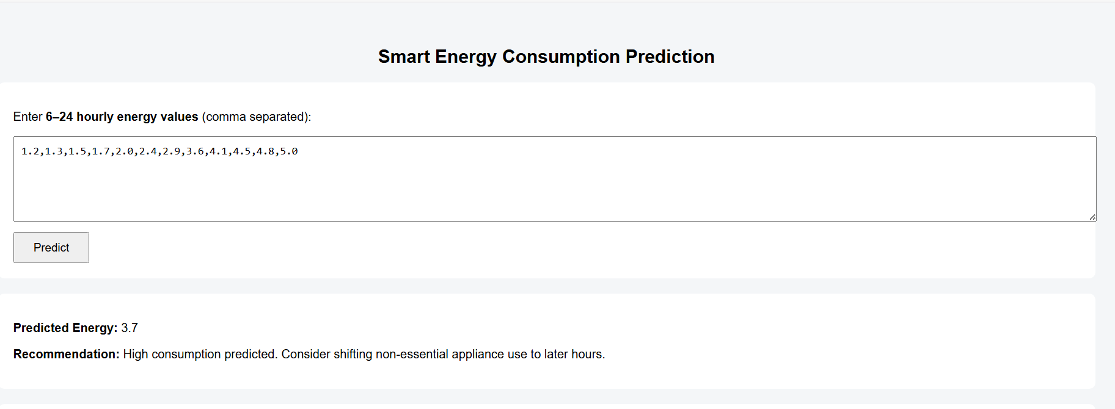
Prototype / Implementation

Slide 14
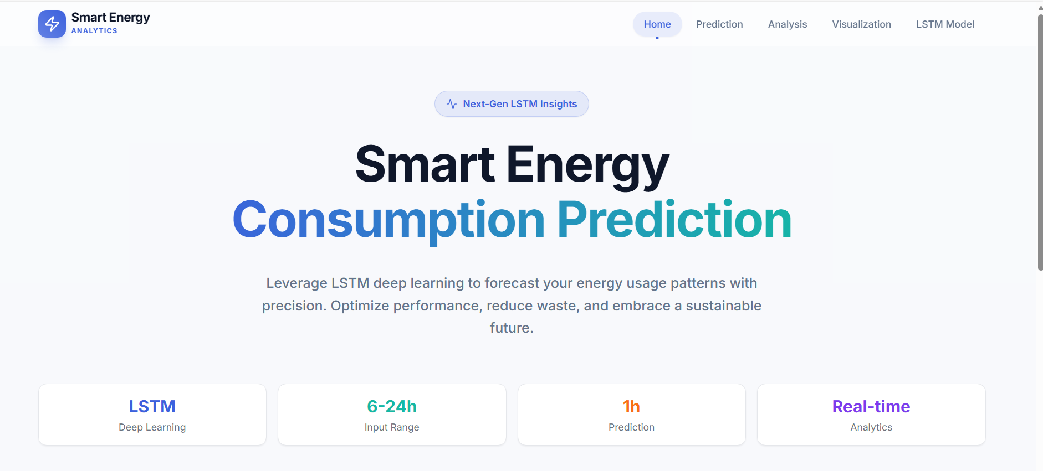
Results & Analysis

Slide 15
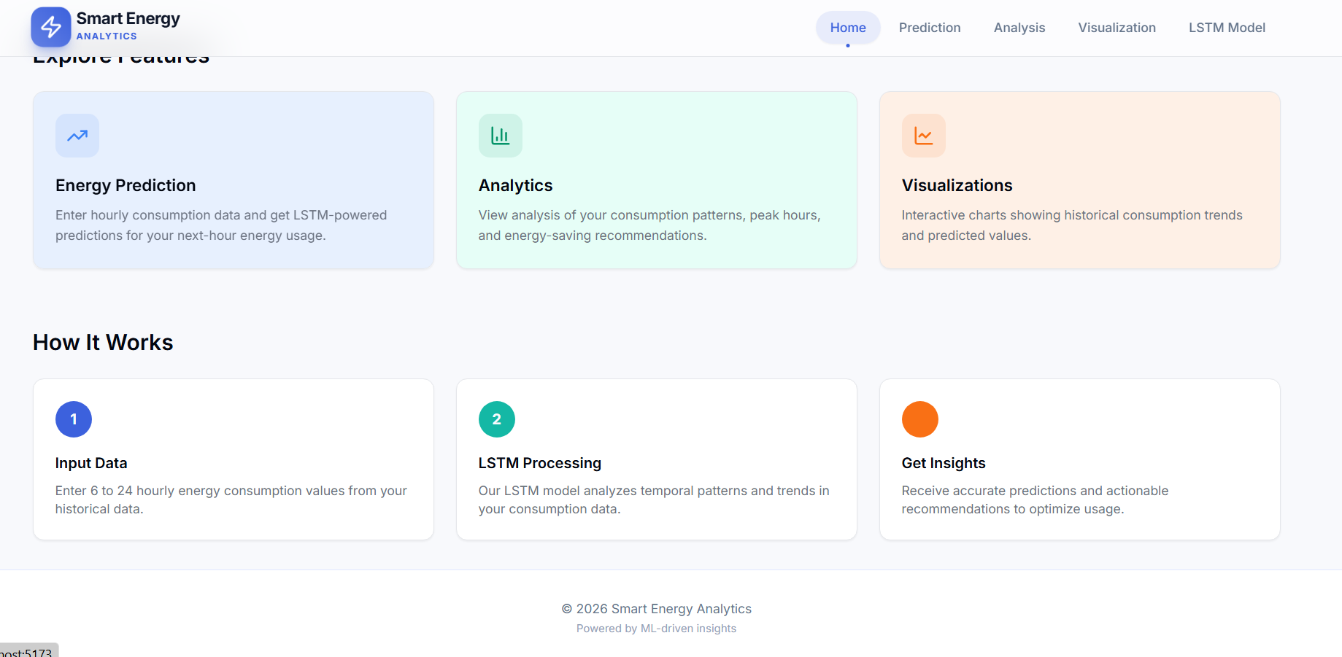

Slide 16
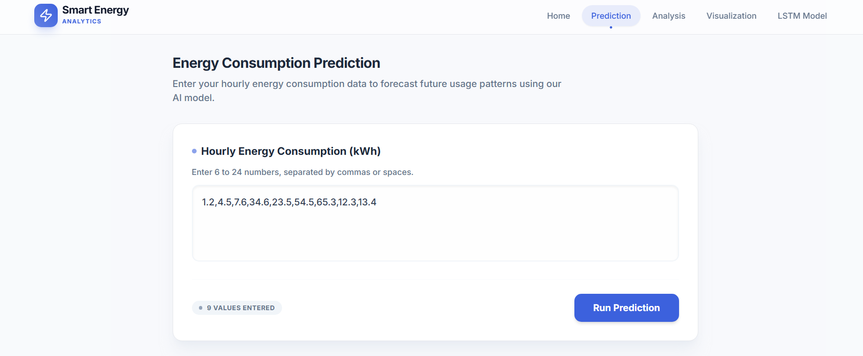
Results & Analysis

Slide 17
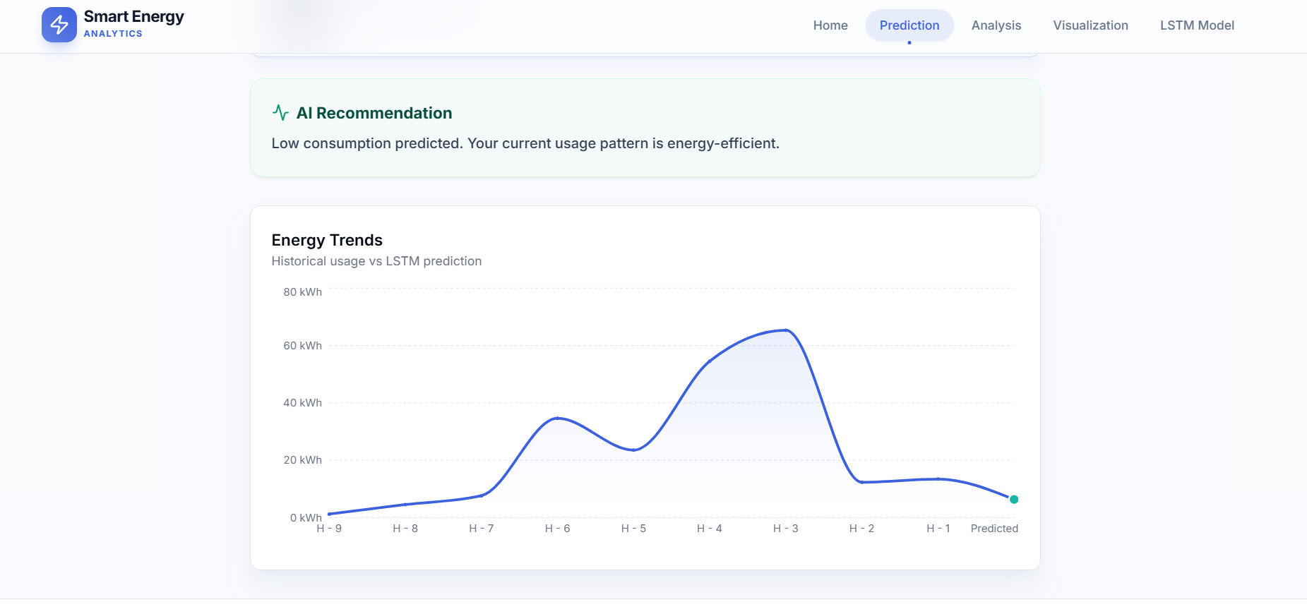
Results & Analysis

Slide 18
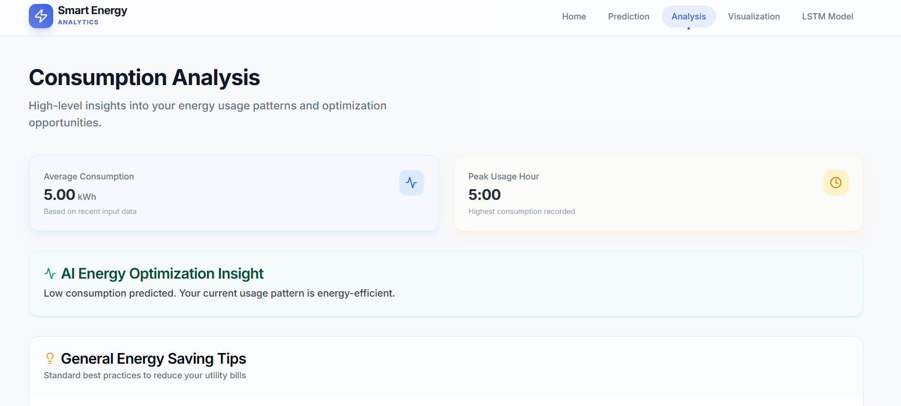
Results & Analysis

Slide 19
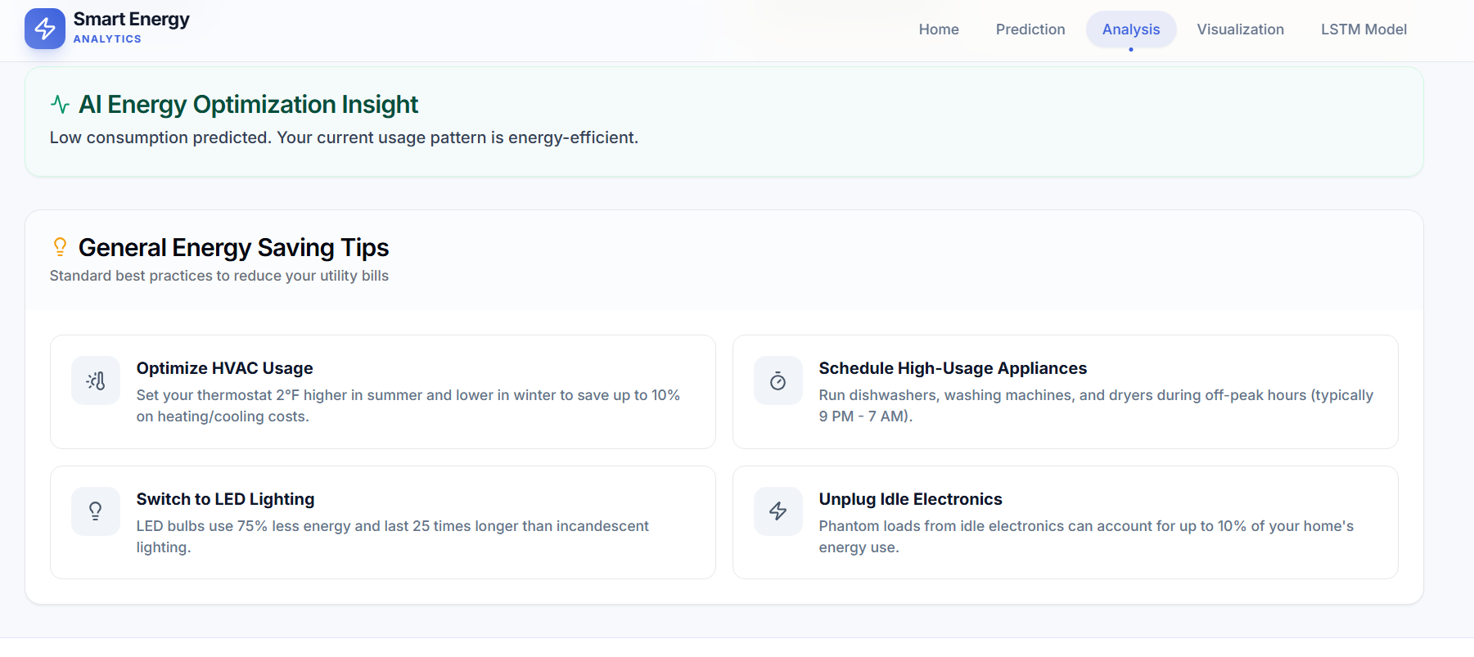
Results & Analysis

Slide 20
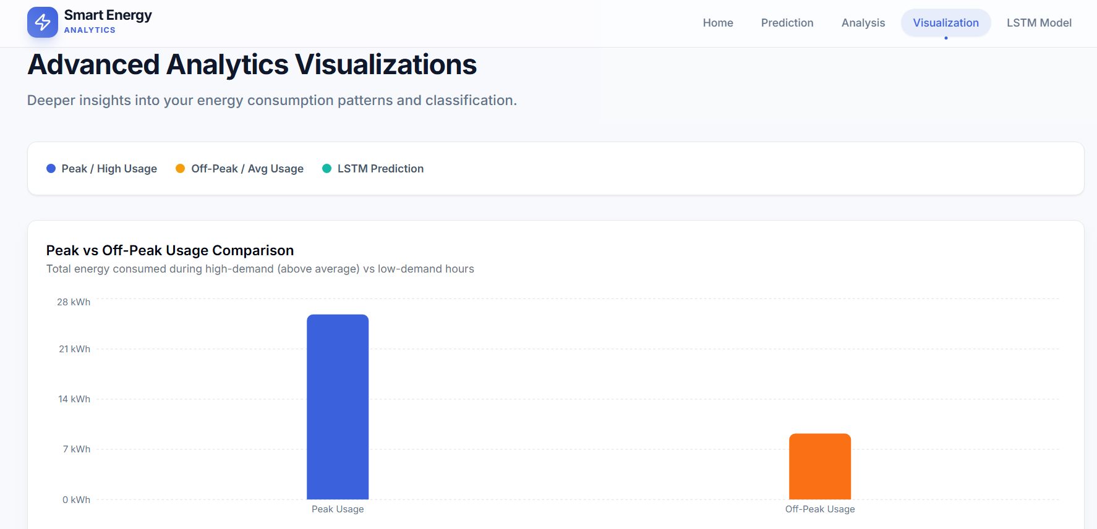
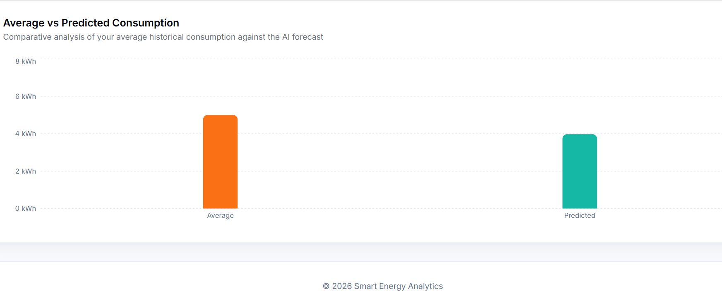
Results & Analysis

Slide 21
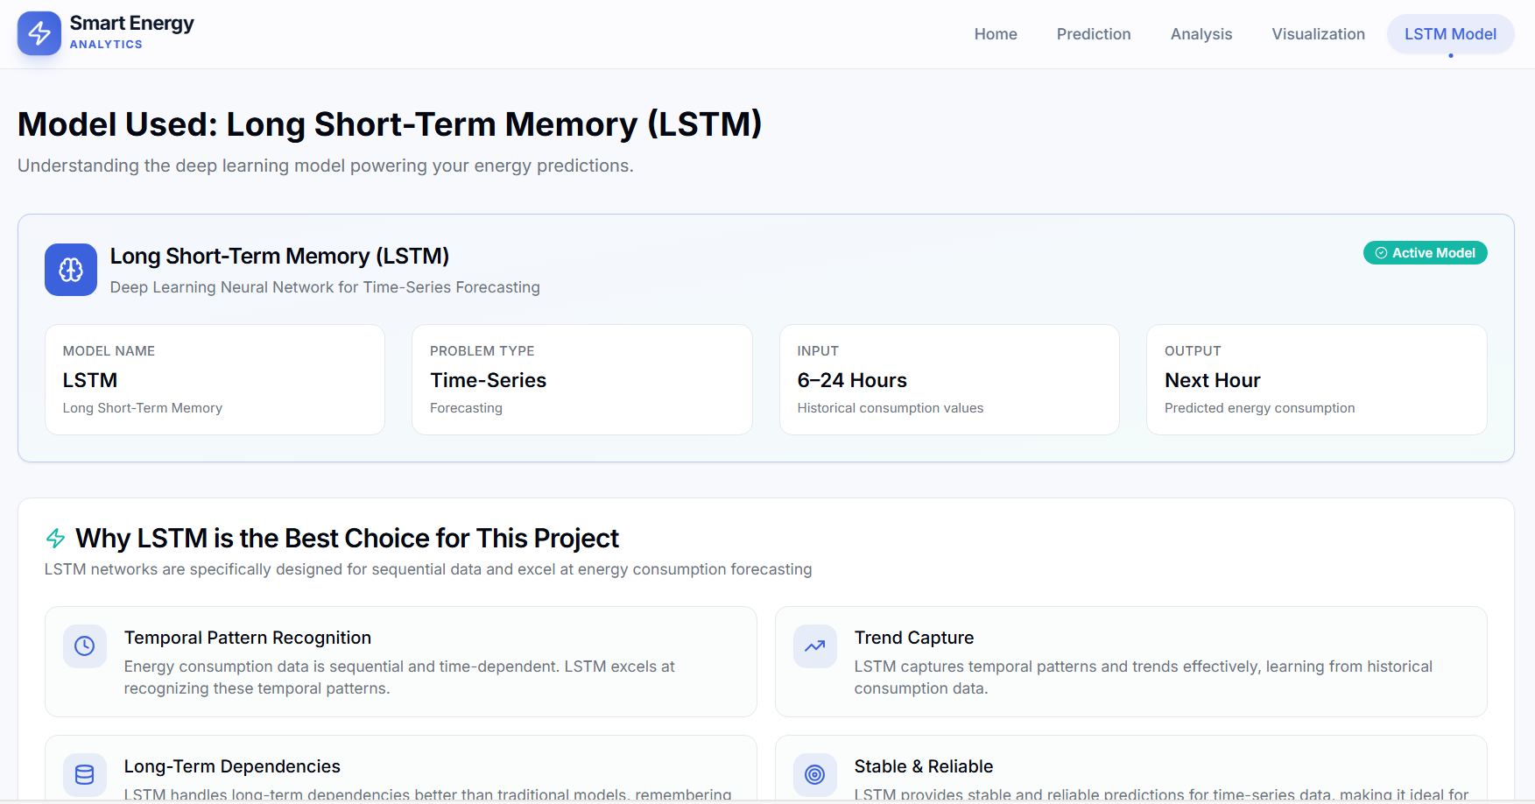
Results & Analysis

Slide 22
Future Enhancements
The system helps in reducing electricity bills, improving energy efficiency, minimizing peak load, and providing a user-friendly energy management platform. However, the system depends heavily on data quality, does not include real-time IoT integration, and requires high computational resources for deep learning models. In the future, the system can be enhanced by integrating IoT smart meters, enabling real-time prediction, supporting renewable energy sources, developing mobile applications, and extending it to smart grid environments.

Slide 23
Conclusion
This project successfully demonstrates a smart energy consumption prediction and optimization system using machine learning and deep learning techniques. It achieves accurate prediction results, improves energy efficiency, and reduces electricity costs. The system proves to be practically useful and scalable for future smart energy management applications.

Slide 24
References
[1] Kaggle, “Household Electric Power Consumption Dataset”
[2] Scikit-learn Documentation, Machine Learning in Python.
[3] TensorFlow Documentation, Deep Learning Framework for Predictive Modeling.
[4] PyTorch Documentation, Deep Learning Framework for Energy Forecasting Models.

Slide 25
Thank You

